Slide 1
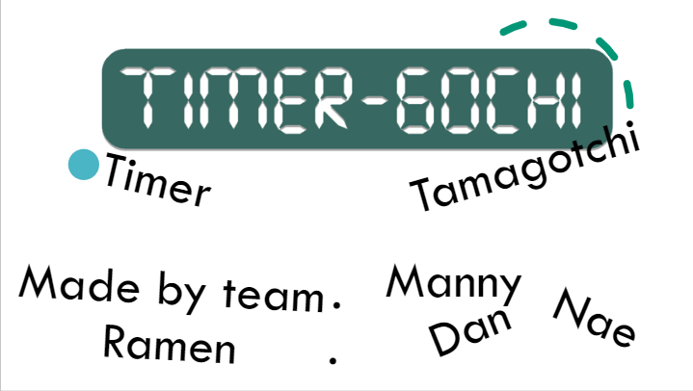

Slide 2
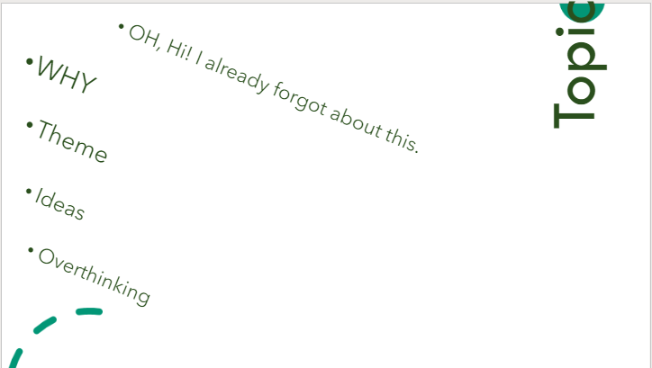

Slide 3
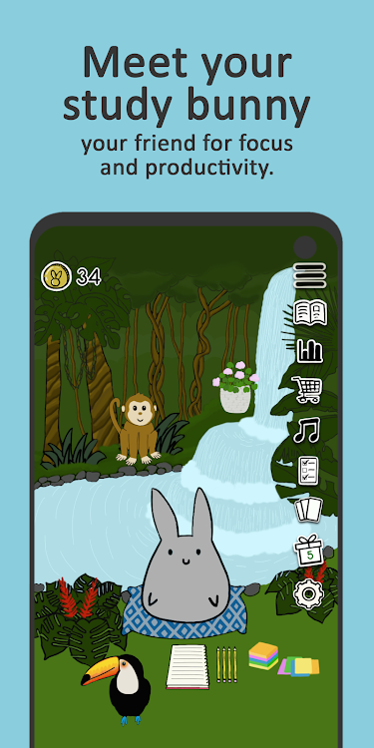
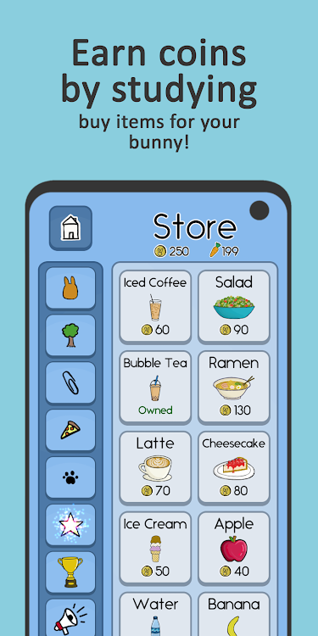
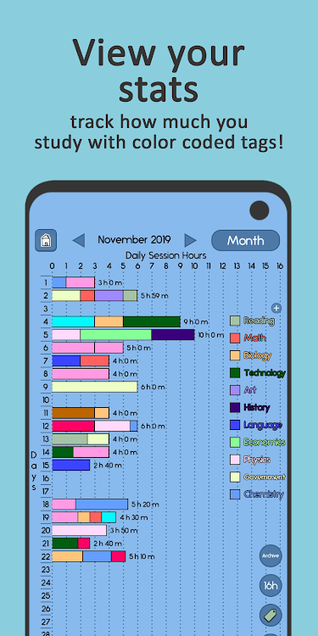
Market Research
1. Study Bunny: Focus Timer
- Background art on pet activity
- Various items to shop
- Stats table to show how much user studied
- Heavy Engine for Android app (Unity)

Slide 4
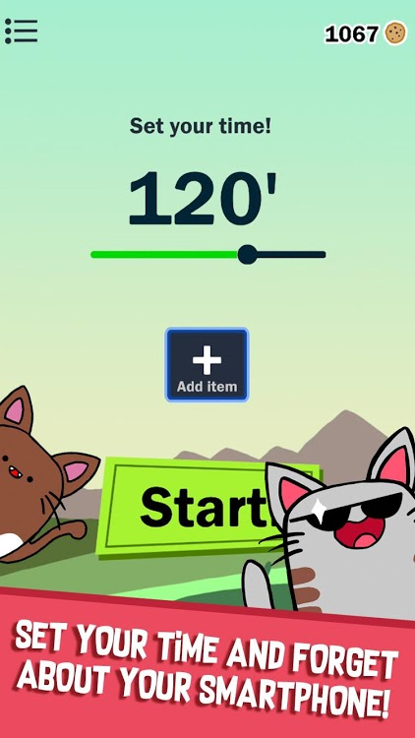

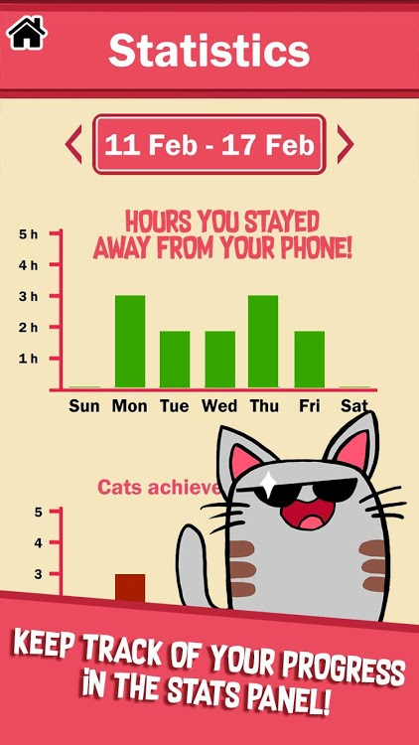
2. Focus Cat App - Focus Timer
- No To-do list
- Tons of character customisation
- Stats to track how long user is away from phone

Slide 5
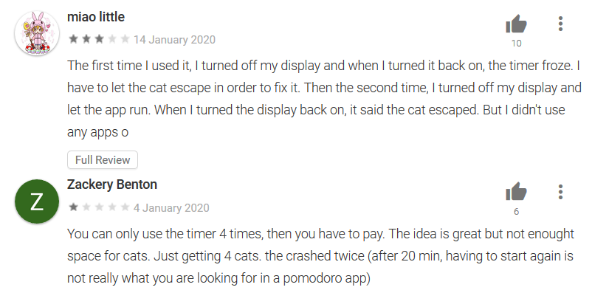
- Crash report from user reviews - Too much pay-to-win features

Slide 6




Target audiences for Timer-G0ch1
Student
Man of bad time-management
Pet lover
Casual Gamer

Slide 7



Business Needs for Timer-G0ch1
Simple for everyone
Eye catching UI
Work as user expected
Fun

Slide 8
Main Features
Virtual Pet
Todo List
Pomodoro Timer
Shop
Record

Slide 9
Todo List
Add, remove, rename and reorder tasks
Set due dates
Set labels and colour code
Set repeat days

Slide 10
- Alarm till 1 hour
(Default time is 30 minutes)
- Adjustable Duration with a scroll bar
- Start, pause, reset, stop button
- Interaction with To-do list activity
- Schedule Breaks
- Pomodoro timer with 30 minutes break after 5 times of mini-breaks
Timer

Slide 11
Shop & Pet
Buy food, modifications and accessories at the shop
Name your pet
Feed, modify and dress pet
Petting increases happiness
Hunger increases over time, happiness decreases when hungry

Slide 12


